Slide 1
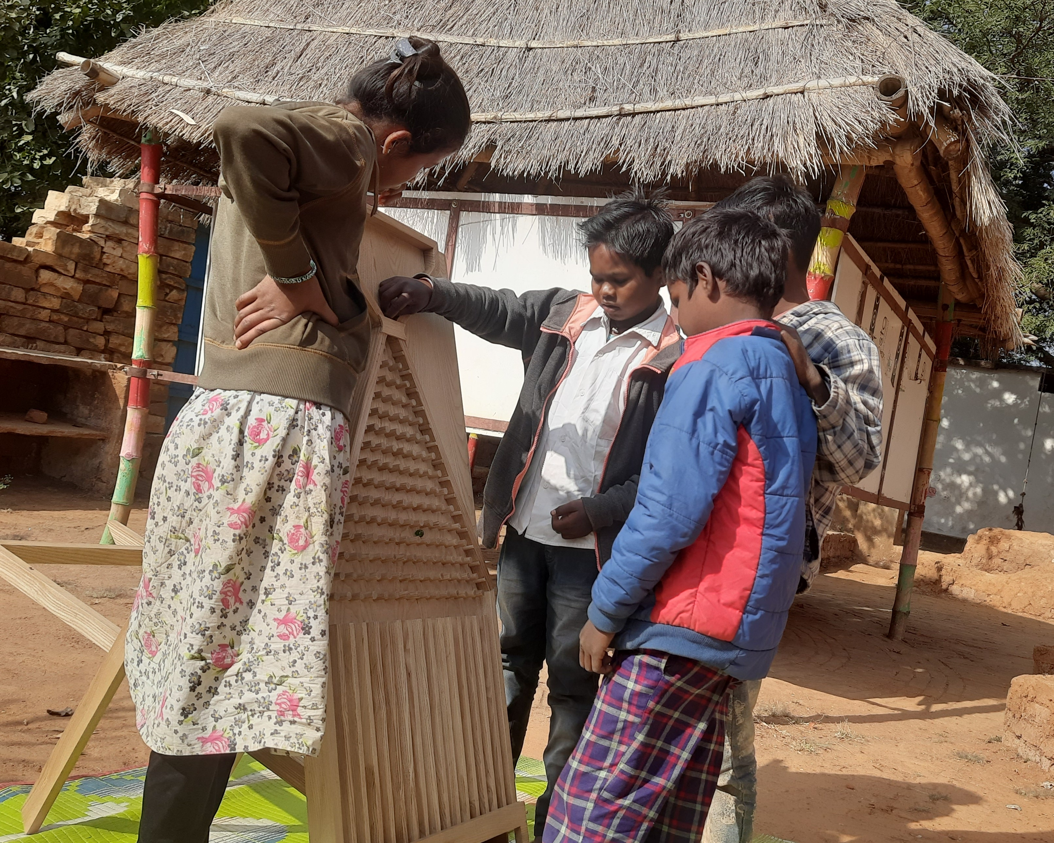
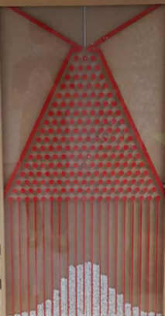

Galton Board or
Quincunx
Thanks to the financial support of:
SSS - Swiss Statistical Society
SAIS – Associazione Accademici Italiani in Svizzera
Rotary Club Valdigne-Courmayeur

Slide 2
The Galton board is named after Sir Francis Galton, an English mathematician and statistician who developed the board in the late 19th century as a way to explain statistical concepts
Sir Francis Galton was a cousin of Charles Darwin. In fact, Galton was greatly influenced by Darwin's work on evolution and natural selection

Slide 3
Galton Board: how to play
First let one ball fall and try to guess in which box at the bottom it will end.
It is quite hard to predict!
If a kid guess is exactly right the kid gets 3 points
If the guess is one off she gets 2 points
If it is 3 off she gets 1 point
Otherwise zero points.

Slide 4
Then let a hand full of balls fall and try to guess how many
will end in the most lateral boxes (far right or far left).
If the kid guessed 10 and no balls end up in the far right she looses 10 points.
If the kid guessed 10 and 1 ball is in the far right she looses 9 points (10-1). And so on
Now let all balls fall.
What do you think will happen?
Can we predict where they will end up?

Slide 5
Galton Board: what to learn
Balls fall in a disordered and chaotic way but, as if by magic,
at the base they are channeled into different boxes ALWAYS forming the profile of a “bell”
known as the Gaussian or Normal or bell-shaped distribution.
How is this regularity justified/achieved?
On each peg the single ball can "decide" to bounce to the right or to the left.
If the ball "wanted" to go to the last box on the right, it should "decide" to always bounce to the right.
In other words, there is only one path that would take the ball to the far right box.
The same is true for the last box on the left.
Instead, there are many more paths that take a ball to the middle boxes.
For example, a bounce to the right followed by one to the left and so on bring the ball to the central box.
But also: two bounces to the right and two to the left and so on bring the ball to the central box.
Generally speaking, it is enough that the number of steps/bounces made to the right
is the same as the number of steps made to the left for the ball to end up exactly in the central box.

Slide 6
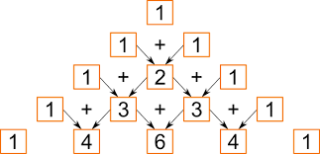
If there were only 4 layers of pegs (in your board I think there are 14 layers) the number of paths leading exactly to the central box would be 6 as shown in the last line of Tartaglia's triangle below. Can you find all the possible paths that lead to the central box?
Layer 1
Layer 2
Layer 3
Layer 4
In the Tartaglia’s triangle each number is the sum of the numbers above it as in the picture.
The Indians knew about this triangle even before the Europeans.
Exercise: complete the triangle with more layers

Slide 7
If there were only 4 layers of pegs the number of paths leading exactly to the second to last box on the left would be 4 as shown in the last line of Tartaglia's triangle below.
Can you find all these paths?
Layer 1
Layer 2
Layer 3
Layer 4
And what is the number of paths leading to the second to last box on the right?
There are interesting simmetries!

Slide 8
What do we learn for real file?
Each ball can be considered as a person
When people take binary decisions (with only 2 possible options like vote or not vote, go to school or not go to school, travel or not travel) they act like a ball that «decides» to go right or left
If the decisions of people are independent from each other then we can study the outcome of many such decisions taken by many people using the Gaussian curve
Carl Friedrich Gauss was a German mathematician, physicist, and astronomer who lived from 1777 to 1855. He is considered to be one of the greatest mathematicians of all time

Slide 9
Galton Skate-Board on paper (or ground)
Print (or draw) the image in the next page
As an alternative: draw the image on the ground/sand

Slide 10

START
6
7
FINISH
1
3
4
5
2
THE GALTON-SKATE-BOARD !

Slide 11
How to play with the Galton-Skate-Board game
Each kid has a small piece of wood representing a skateboard
if the game is on paper, otherwise on ground kids use their skateboards
Each kid has a coin that is tossed 6 times
The skateboard starts from «start» and ends on the «finish» line
Every time the coin toss is H the skateboard slides down to the right red circle one step
Every time the coin toss is T the skateboard slides down to the left red circle one step
In which final position (1, 2 ….or 7) will the majority of skateboards end up?
NOTE: The more kids play the less uncertainty there will be in the result !
Each kid can play multiple times keeping track, each time, of the final position

Slide 12
You can substitute coin tosses (with head and tails as
possible outcomes) with stones, black and white
You have a bag with an equal number of black and white stones and in turn kids selects 6 stones: if the stone is white they slide thier board to the left red circle, if it is black they slide their skateboard to the right red circle
Once a kid is done her stones are placed back in the bag and the next kid starts

Slide 13
Insert the final position for each kid in each play
 | PLAY 1 | PLAY 2 | PLAY 3
KID 1
KID 2
KID 3
KID 4
KID 5

Slide 14
EXAMPLE of a Galton-Skate-Board game
 | PLAY 1 | PLAY 2 | PLAY 3
KID 1 | Final positon 5 | Final positon 4 | Final positon 3
KID 2 | Final positon 4 | Final positon 3 | Final positon 5
KID 3 | Final positon 4 | Final positon 1 | Final positon 4
KID 4 | Final positon 3 | Final positon 4 | Final positon 5
KID 5 | Final positon 6 | Final positon 3 | Final positon 2
Final position 1: reached 1 time
Final position 2: reached 1 time
Final position 3: reached 4 times
Final position 4: reached 5 times
Final position 5: reached 3 times
Final position 6: reached 1 time
Final position 7: reached 0 time
Note: there are in total of 15 squares
Which is the same as the total
number of plays (5x3)
1
2
3
4
5
6
7
FINAL POSITION

Slide 15
Histogram
The picture you see at the bottom is called histogram and is a graphical representation of data.
It consists of a series of bars that are of equal width.
The height of each bar represents the frequency or count of observations each outcome of the game.
1
2
3
4
5
6
7

Slide 16
Explanation
The majority of skateboards will end up in position 4
Very few will end up in positions 1 and 7
Why?
There is only one path that leads to final position 1: T, T, T, T, T, T
There is only one path that leads to final position 7: H, H, H, H, H, H
There are many paths that lead to the central final position 4, for example:
H, T, H, T, H, T or T, T, T, H, H, H or H, H, H, T, T, T
In general every path with 3 Hs and 3 Ts leads to final position 4

Slide 17
Real life applications
The Galton board illustrates the Central Limit Theorem a theorem that is CENTRAL to predictions that become more reliable as the “sample size” becomes larger and larger (in the LIMIT)
Heights of kids: say 20 kids are playing the game
Measure their heights and compute the average height (the mean)
Let’s call this average the population average
Each kid takes a paper and writes his/her name
Papers are placed in a box and at random (without looking) 10 names are selected. The average height of the selected (sampled) kids is computed. Let’s call this average the sample average
The Central limit theorem tells us that the sample average should be very close to the population average
If fewer kids are selected, say 5, they two averages should still be close but possible less close.
If only 1 kid is selected it is hard to say anything about her height
This is similar to what happens when we toss a single ball in the Galton board: it is hard to predict where it will end up
If we have a handful of balls then it is easier

Slide 18
Potatoes weight
Collect at random from the field (all locations in the field should be covered) 20 potatoes and measure their weights using a scale
Compute the average weight
Does it make a difference if we put all potatoes on the scale and then divide by 20 or should we weigh each single potato then sum and divide by 20?
Now collect at random 10 new potatoes and compute their average weight
The Central limit theorem tells us that the two averages should be quite close

Slide 19
Other real life applications
Salary of people in a village: it is too time consuming to ask each person in the village their salary and then compute the average salary in the village.
It is much easier to take a random sample pf people in the village and compute the sample average
The Central limit theorem tells us that the average salary in the village is very close to the sample average. And they become more and more close the larger is the number of people in the sample
Height of plants

